Slide 1
GBSSA KEYNOTE: UTILIZING TECHNOLOGY TO TRANSFORM THE STUDENT EXPERIENCE, MARKET PROGRAMS, AND ENHANCE THE STUDENT LIFE CYCLE
November 8, 2019
Matt Baca, M.A.Ed.
matt.baca@colorado.edu
matt@mbaprepinternational.com
www.mbaprepinternational.com
merage.uci.edu

Slide 2
Objectives of the Keynote
After the completion of this workshop you will be able to:
Identify practical methods, using technology, to connect with your students, promote your program and create an overall value-add for the student experience and programs
2. Recognize how to put these methods together in a cohesive package, create systems to do the heavy lifting and to save time and resources in the process

Slide 3
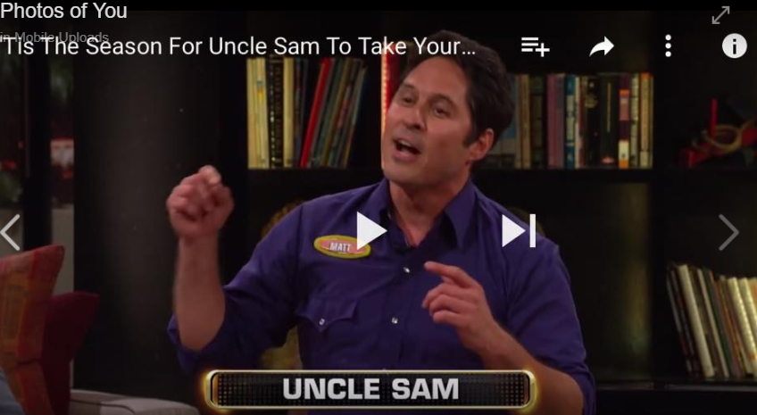
About Matt Baca
EDUCATION
BUSINESS
ENTERTAINMENT
Notes:
My three areas of focus for years has been education, business and entertainment.

Slide 4
PART I: TELLING YOUR STORY

Slide 5
Questions for Discussion: The Power of Story
•What elements make for a good story?
• What’s the last really good TV show or movie you saw that you loved? What made it an effective story? What elements did it have that made you fall in love with it?

Slide 6
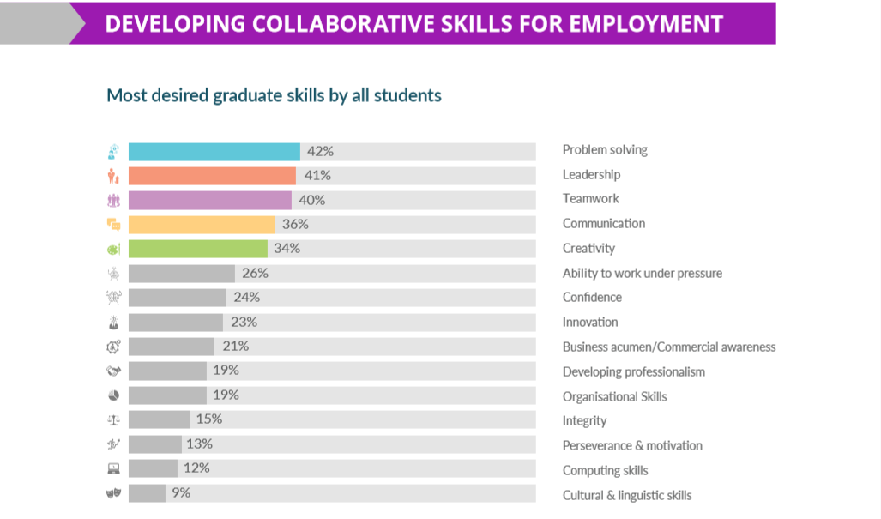
Communication
Problem Solving
Presentations
Leadership
Networking
Teamwork
Storytelling
Communication
Behavioral Interviews
Creativity

Slide 7
REPORT FRAMEWORK | STORY FRAMEWORK
TOPICAL
NARRATIVE
DATA
MEANING
INFORMATION
STORY
FACT
METAPHOR

Slide 8
Act I
Act II
Act III
Climax
INCREASING TENSION
EVERYTHING CHANGES
Denouement
Setup
Three Acts
merage.uci.edu

Slide 9
Act I
Act II
Act III
Climax
INCREASING TENSION
EVERYTHING CHANGES
Denouement
Setup
Three Acts
merage.uci.edu

Slide 10
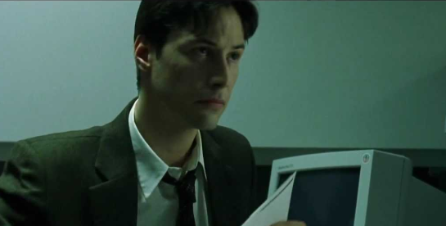
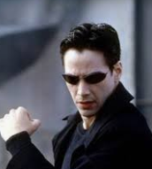
Act I
Act II
Act III
We see the Character in their Old World
Character goes back to the Old World, changed
The Character is Introduced to
the New World
Setup
Three Acts
merage.uci.edu

Slide 11
Questions for Discussion: Your Story
•What is your business school’s story?
• What is unique and attractive about your school your applicants?
What are success stories of students you use as an illustration of the story?

Slide 12
Questions for Discussion: Your Story – Examples

Slide 13
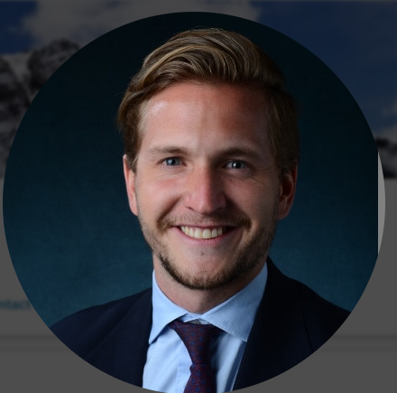
Questions for Discussion: Your Story – Examples
Nicolas Fernandez, ‘18 MBA, Finance
•Friends from Mexico went to Ivy League MBAs; did not get jobs & saddled w/ debt; he got a job in NV
• Boulder: high quality education & work-life balance
Utilized the CO alumni network
Wants to give back and help both Domestics & Internationals

Slide 14
Questions for Discussion: Your Story
•What connections can you make in your story with technology in relation to:
Marketing Program
Transforming the Student Experience
Enhancing the Student Life-Cycle

Slide 15
PART II: THE STUDENT DEMOGRAPHIC

Slide 16
Questions for Discussion: Knowing Your Demographic
•What is the demographic of your students/target audience for each program? (Consider both domestic & international)
• How is technology used by each demographic?
How well is your program in regards to technology (in marketing, curriculum, student engagement) adapting to changes in technology and trends?

Slide 17
PART III: BEST PRACTICES USING TECHNOLOGY

Slide 18
OVERVIEW OF THE STUDENT LIFE-CYCLE

Slide 19
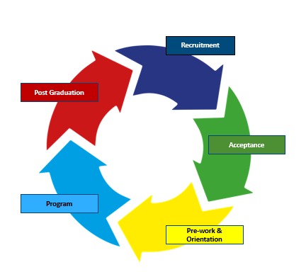
The Student Life-Cycle
Recruiting
Acceptance
Pre-work & Orientation
Program
Post Graduation
Notes:
We’ll review each of these in depth,.

Slide 20
The Student Life-Cycle
Recruiting
Acceptance
Pre-work & Orientation
Program
Post Graduation

Slide 21
Questions for Discussion: Recruiting/Marketing Stage
•How are you using technology in the recruitment or marketing phase to differentiate yourself in the market?
• Does this strategy change between international and domestic recruitment? Does it change depending on the program (MBA, MS, etc.)
• What are the challenges at this stage for using technology?
How effectively are you utilizing alumni in this stage?

Slide 22
Technology Used During Recruiting/Marketing
• Social Media: How well are you utilizing social media to promote to key groups? (Thai Alumni Group & CU, 1 Million Cups and Masters of Innovation & Entrepreneurship)
• Videos and Marketing: Depending on how well known your school is, are you using a sizzle reel (:30 second video) highlighting the FAB’s of the university? (i.e. sell Boulder on the work/life balance, the mountains, the Tech Scene)
• How connected are you to the alumni network? Do you have a contact who reaches out to alumni?

Slide 23
The Student Life-Cycle
Recruiting
Acceptance
Pre-work & Orientation
Program
Post Graduation

Slide 24
Questions for Discussion: Interview/Acceptance Stage
The student is being interviewed by admissions.
How are you using technology in this phase?
Does this strategy change between international and domestic recruitment?
What are the challenges at this stage for using technology?

Slide 25
The Student Life-Cycle
Recruiting
Acceptance
Pre-work & Orientation
Program
Post Graduation

Slide 26
Questions for Discussion: Pre-work & Orientation/Onboarding Stage
The student has been accepted to the program.
How are you using technology in this phase between the time they are accepted to the time the program starts?
Does this strategy change between international and domestic recruitment?
What are the challenges at this stage for using technology?
How do you tell your story?

Slide 27
The Student Life-Cycle
Pre-work & Orientation
JANUARY: STUDENT ACCEPTED | FEBRUARY | MARCH | APRIL: | MAY: | JUNE: | JULY: | AUGUST: MBA BEGINS
“NO MANS’ LAND”
Very few are working on soft skills, communication, personal development
Notes:
Most students enter No Mans’ Land: That time after they are accepted and the time their program starts. They aren’t doing anything to prep for the program, save from a business math class. These few months are an opportune time to create value-add learning for the student, and gets them ready for their program in the fall.

Slide 28
Orientation Pre-Work (eLearning)
Students are provided assignments, including:
Read a business case
Provide a write-up of the case (post on Canvas by X date)
Read about STAR Model/Behavioral Interview
Watch video on START Model
Send me the video of your behavioral interview
Listen to the Meet the Influencers podcast
Tude App assignment
Conduct one-on-one Skype conversation (what will create urgency and immediacy?)
Upload all information onto Canvas (Utilize Canvas as an onboarding tool)

Slide 29
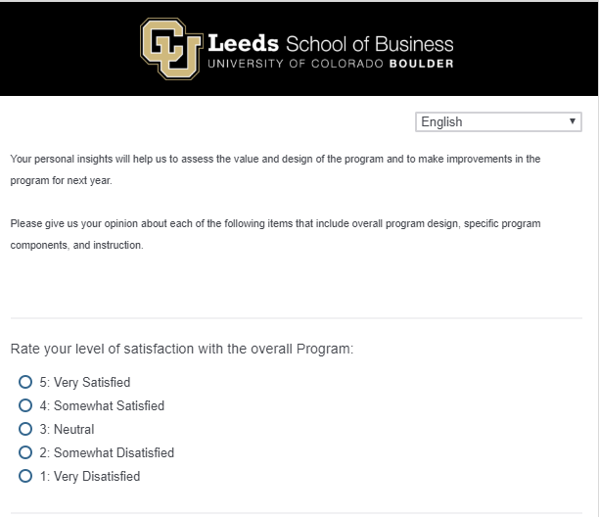
Qualtrics Surveys

Slide 30
Qualtrics Surveys
Surveys are administered online.
Surveys are administered:
When students are accepted to the program, and before the Bootcamp begins
To American and International Candidates
At the end of MBA/MS Bootcamps
At various intervals for the student throughout the program: 1 month, 3 months, 6 months, a year
How can we improve the orientation program?
How can we improve marketing the program?

Slide 31
Qualtrics Surveys: Benefits
Provides timely information to make improvements in marketing, recruiting and orientation programming
Helps students see that they have a voice in the program
Helps students know that they haven’t been forgotten

Slide 32
The Student Life-Cycle
Recruiting
Acceptance
Pre-work & Orientation
Program
Post Graduation

Slide 33
Questions for Discussion: Program Stage
The student has now begun their program.
How are you using technology in this phase?
Does this strategy change between international and domestic recruitment?
What are the challenges at this stage for using technology?
How do you involve your school’s story in this stage?
What other apps or platforms might you use throughout the program to elicit engagement?

Slide 34
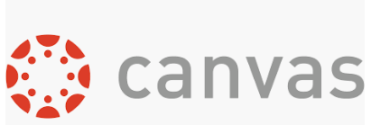
Questions for Discussion: Program Stage

Slide 35
Online Platform: Ryan & Paul from CU Boulder
UCI utilizes Canvas for course websites university wide. Can use Canvas but it’s a different version so they utilize an intranet website that was made student centric.
Can do announcements and has helped cut down on the number of emails.
Allows students to pull the information vs having to send it out every time.
Utilize calendars that are specific to each individual program.
Acts as the link to other resources
Google drive is the main way to share and disseminate information
New platforms are popping up so often that it’s hard to keep up.
Slack, WhatsApp, ect…
Big question is how to monitor those conversations and information
Use a course or major, but cant use for individual courses
Auburn uses Salesforce and builds a community instead of a Canvas page
Post to groups they have instead of emails to individual students
Create their own groups within the community in addition to pre-set student groups
Alumni section for Salesforce so they are still able to be engaged
Have too many platforms being used (Slack, Blackboard, Google Calendar, WeChat)
Trying to get students onto official platforms is difficult
Still have email as primary communication, but students aren’t reading it
Transitioning from Blackboard to Canvas, but also building an “In-house” system
Does Canvas have any ability to create an outward facing website that none students can access?
Have a similar set up to CU Boulder but also have a directory with student information so they can get to know each other.
Utilize Canvas as an onboarding tool before they come to campus
Have a Canvas site just for orientation that students are able to access via the Canvas app once they are accepted to the program.
Over saturation of programs for students to use. Currently have used Canvas for 5 years and now am transitioning to work with Salesforce as well.

Slide 36
Managing Student Experience: Cori & Marisa (ASU)
Review the notes online:
Canvas – Onboarding Tool: how would you use specifically for engagement and include your story?
Building alumni networks – connecting them with current students – leverage the power of story!
Yapp
What’s on your wish list for technology?

Slide 37
Technology Used During Programs
UCI brings me back every year to do one-on-one coaching. I watch their previous intake videos from 7 months ago and can diagnose what they need (creates value-add)
Utilizing Skype meetings for coaching
Surveys to engage students
Matchmakers – clearinghouse for all available alumni to help with mentoring, developing ongoing relationships

Slide 38
Student Engagement Among:
Students
Alumni
Career Center
Rec Center
Professors
Mentors
Business Community
Recruiters

Slide 39
The Student Life-Cycle
Recruiting
Acceptance
Pre-work & Orientation
Program
Post Graduation

Slide 40
Alumni Database
All information on alumni is in a database through the university
Candidate can click on country/region or area of study
Bio/Pictures/Contact info/Videos appear
Can connect with Outlook to send regular reminders for candidates to reach out

Slide 41
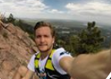
Leeds Business School Database
Bunga Anti
Nicolas Fernandez, ‘18 MBA, Finance
Raja Teja
In the video alumni shares briefly of:
How they chose CU Boulder
What’s the value add going to CU
How they secured a job
Hobbies (i.e. hiking, Nick skiing)
Conveys his desire to connect with new students and help them out.
Bio – Brief History
Where works
Hobbies
Contact me at nfern@colorado.edu
Mohammed Al-Salaam
Nicolas Fernandez
Barbara Garza
Video
Nicolas Fernandez
Barbara Garza
Notes:
This is a mock-up of the database, branded with each university.

Slide 42
Alumni Database Benefits
Relatively easy to set up (database through the university, content including names, contact info, bio, pictures, videos)
Can be used during all of the phases of the student’s cycle
Can do the “heavy lifting” in conjunction, admin, etc.

Slide 43
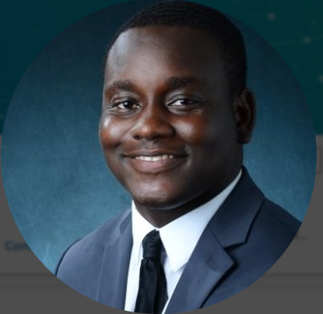
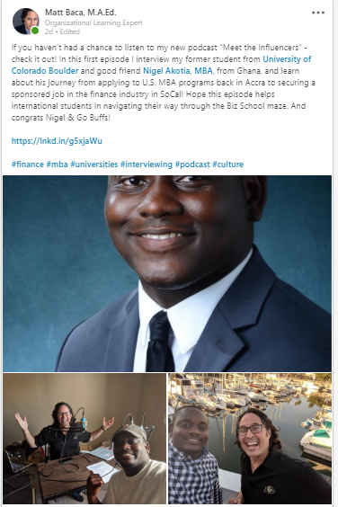
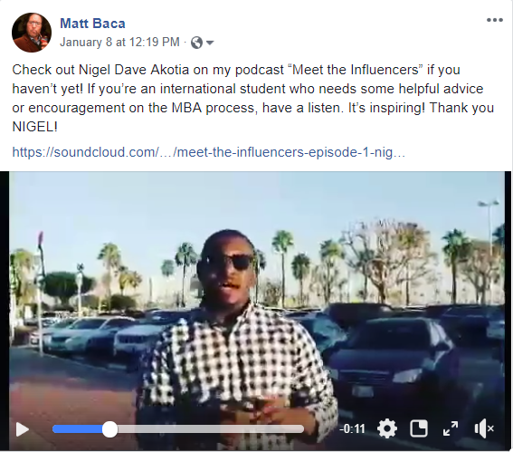
Media Tools: “Meet the Influencers” Podcast

Slide 44
Podcast Benefits
Relatively easy to produce.
One or two students to be interviewed (pick ones who have great stories to tell, who are/were in the similar situation at your current students).
Can be added to marketing, admissions, pre-work stages.

Slide 45
Social Media
In your groups, discuss the following:
What’s currently working for you with social media to engage students?
How are you telling your story through technology? How successful is it? What modifications would you need to make?

Slide 46
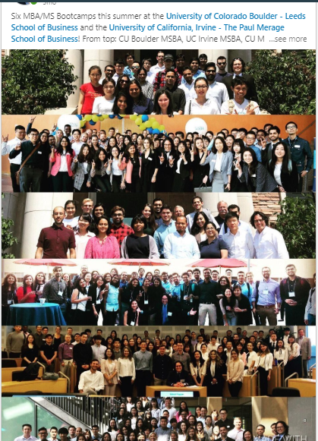
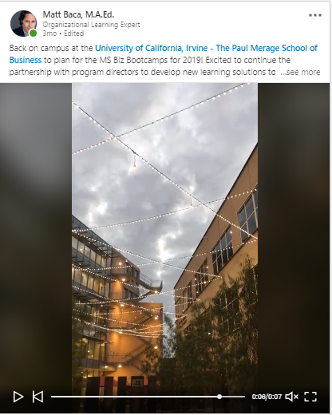
Linked In
Notes:
Here are some examples of my posts on Linked In that garnished a lot of attention and likes. The first is a picture at Irvine campus. The second is a compilation of pictures of the six programs I taught in back in 2018.

Slide 47
PART IV: PUTTING THE PIECES TOGETHER

Slide 48
Final Group Activity
In your groups, discuss the following:
What strategies using technology will we implement for each of the five stages of the student life-cycle?
Make sure that each strategy:
Transforms the student experience, and creates engagement
Markets the Program
Is congruent with your story
Use information learned from sessions/roundtables
At the end of the activity, teams will share their strategy.

Slide 49
Table for Technology Application
Technology to Implement | Result | Resources Needed | Timeline: when to Implement | How will you know you’re successful?

Slide 50
Implementing Technology and Strategy
Alumni Database (add recent graduates)
Online Surveys
Exit Interviews
Marketing Videos
Alumni Database
Online Surveys
Marketing Videos
Social Media Groups
Online Surveys
Skype one-on-one coaching (for internships)
Skype one-on-one Alumni Database
Podcast
Online Surveys
eLearning Pre-Work
Alumni Database
Notes:
We’ll review each of these in depth,.

Slide 51
Questions?

Slide 52
Final Debrief
Share one thing that you learned in this workshop that will help you use technology as a tool for success.

Slide 53
Review of Keynote
You can now:
Identify practical methods, using technology, to connect with your students, promote your program and create an overall value-add for the student experience and programs
2. Recognize how to put these methods together in a cohesive package, create systems to do the heavy lifting and to save time and resources in the process

Slide 54
Thank You!
Matt Baca
matt@mbaprepinternational.com
www.mbaprepinternational.com
720-404-8220
merage.uci.edu

